Slide 1

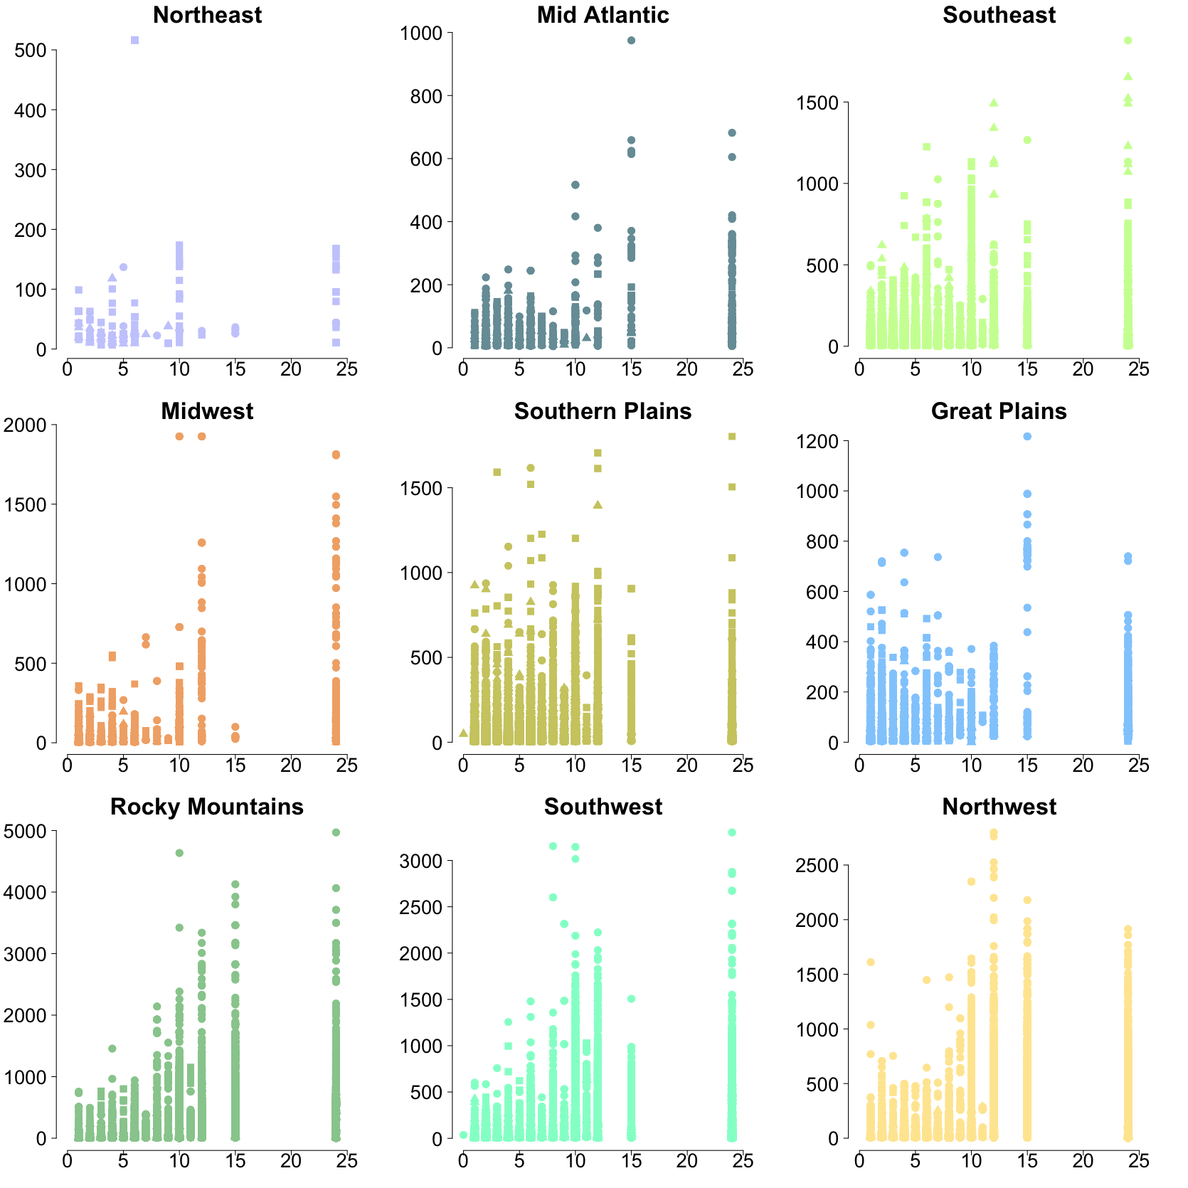
Insights on the relationship between MODIS hotspot detections and fires that trigger NWS smoke forecasts
Steven Brey | sjbrey@colostate.edu
3
HMS duration is proportional to MODIS FRP
Colorado State University
Fort Collins, Colorado
1
Introduction to HMS fires and MODIS detections
The National Environmental Satellite, Data, and Information Service (NESDIS) Hazard Mapping System (HMS) shows the locations of fires that satellite analysist have confirmed produce smoke. These HMS fires are usually detected using visible satellite imagery and are the fires used to initialized the National Weather Service (NWS) smoke forecasts. Each fire is assigned a time stamp, location, and duration of observed smoke production. Brey et. al. [2017] showed that the total duration of observed smoke hours for all HMS fires is proportional to total carbon emissions. This work compares HMS fires to the MODIS 1km pixels Active Fire Product (hereafter simply “MODIS”). This work explores relationships between MODIS and HMS fires on a regional basis.
FRP
This map shows the regions used in this analysis. These regions closely resemble EPA regional office management areas with slight adjustments made for topographic and fire regimes. The colors used in this map are used throughout figures in this poster.
2
HMS detects many fires MODIS misses
HMS Fire Duration (hrs)
This plot shows the relationship between the duration of HMS fires and the mean fire radiative power (FRP) of MODIS detections that were within 4 km of them. In general FRP is bigger for longer lasting HMS fires, but the proportionality changes by region. Notice that the y-axis is not the same for all regions.
4
MODIS confidence is high when near HMS
MODIS detections / per HMS fire
Month
This figure shows the monthly distribution of the number of MODIS detections that fall within 4km of an HMS fire (n=670,000). The box plots show the 2.5, 25,50, 75, and 97.5 percentile values for a given month. The percent given in the title of each panel indicates the percentage of HMS fires that have no corresponding MODIS detections. This percentage could be thought of as the added value of the HMS for a given region, fires that would not be included in an air quality forecasts without the help of the human analyst. HMS and MODIS data shown in this and all following plots ranges from 2006 to 2015.
This figure shows the MODIS fire detection confidence is generally high for MODIS detections within 4 km of HMS fires.
http://atmos.colostate.edu/~sjbrey/
Citations:
https://firms.modaps.eosdis.nasa.gov/download/
http://viirsfire.geog.umd.edu/pages/FAQ.php
Murph

